Slide 1

Option 2 – AirBnB Dataset Tableau Project
Prepared by: Chloe Phuong

Slide 2
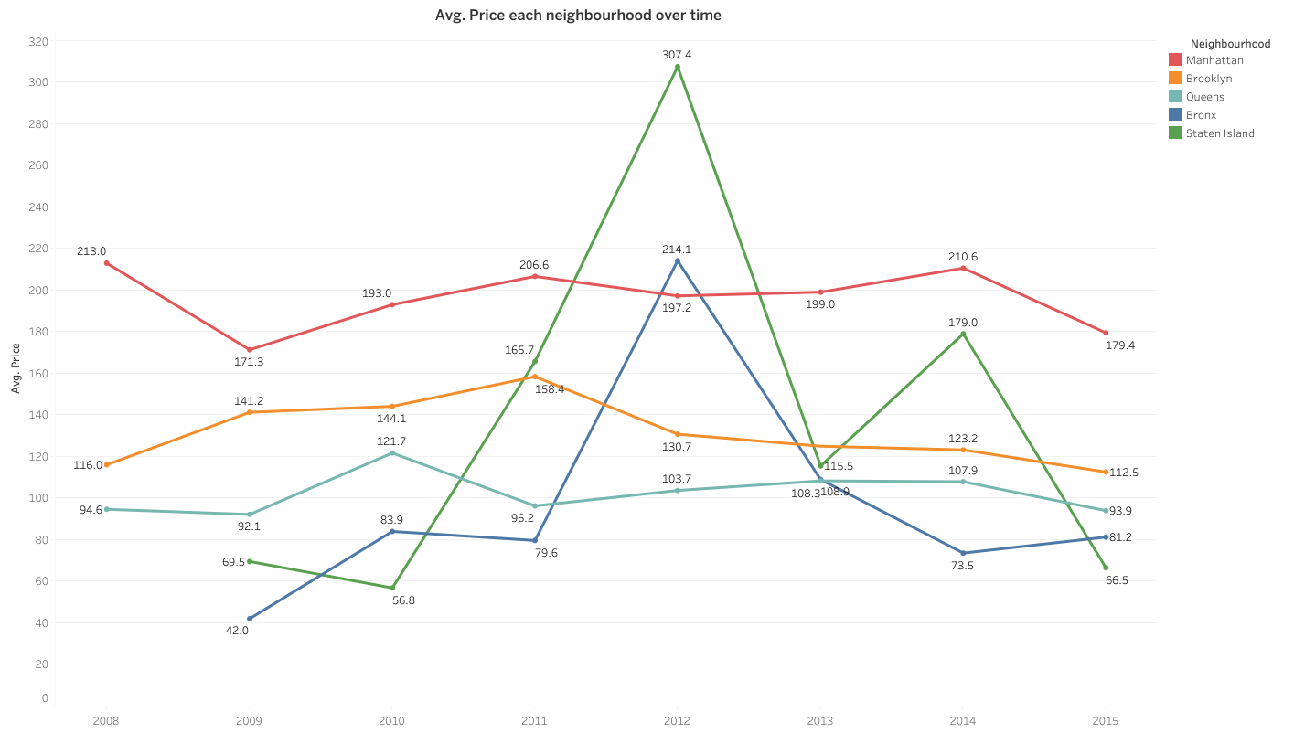

Slide 3
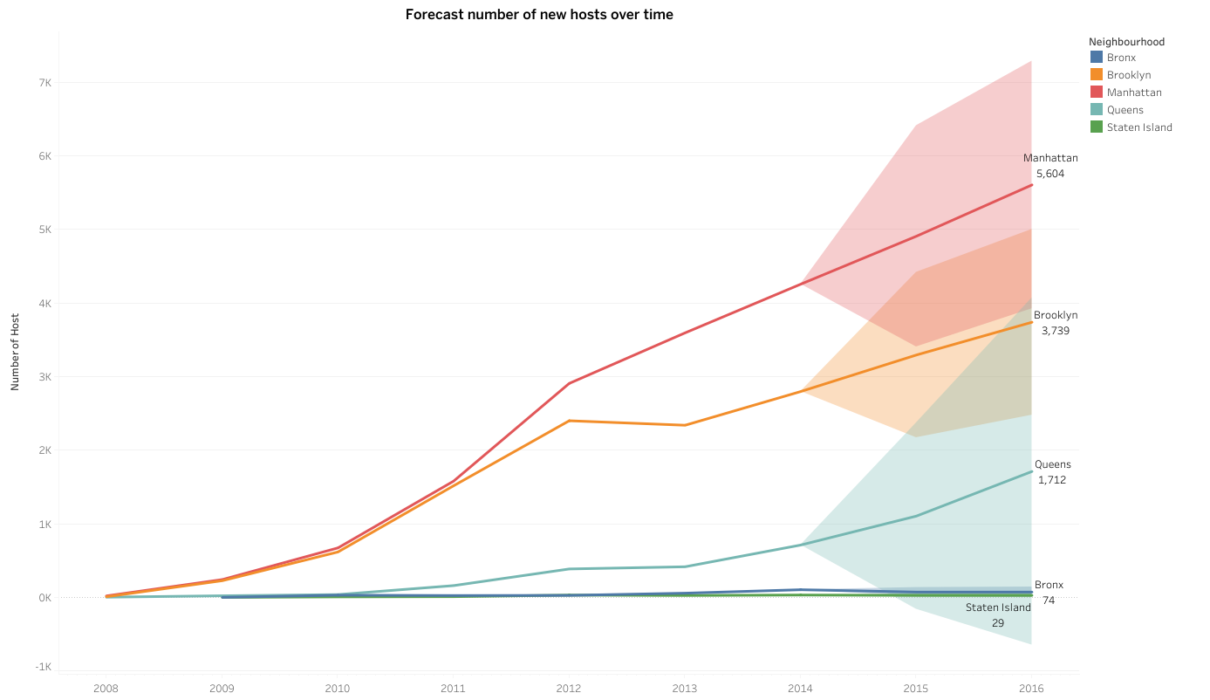

Slide 4
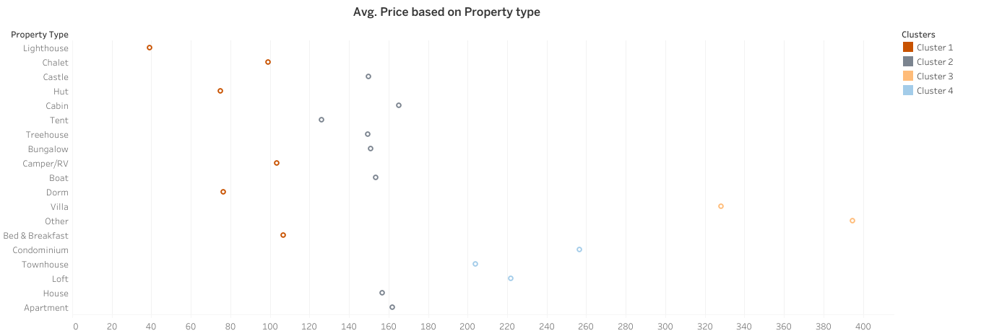

Slide 5
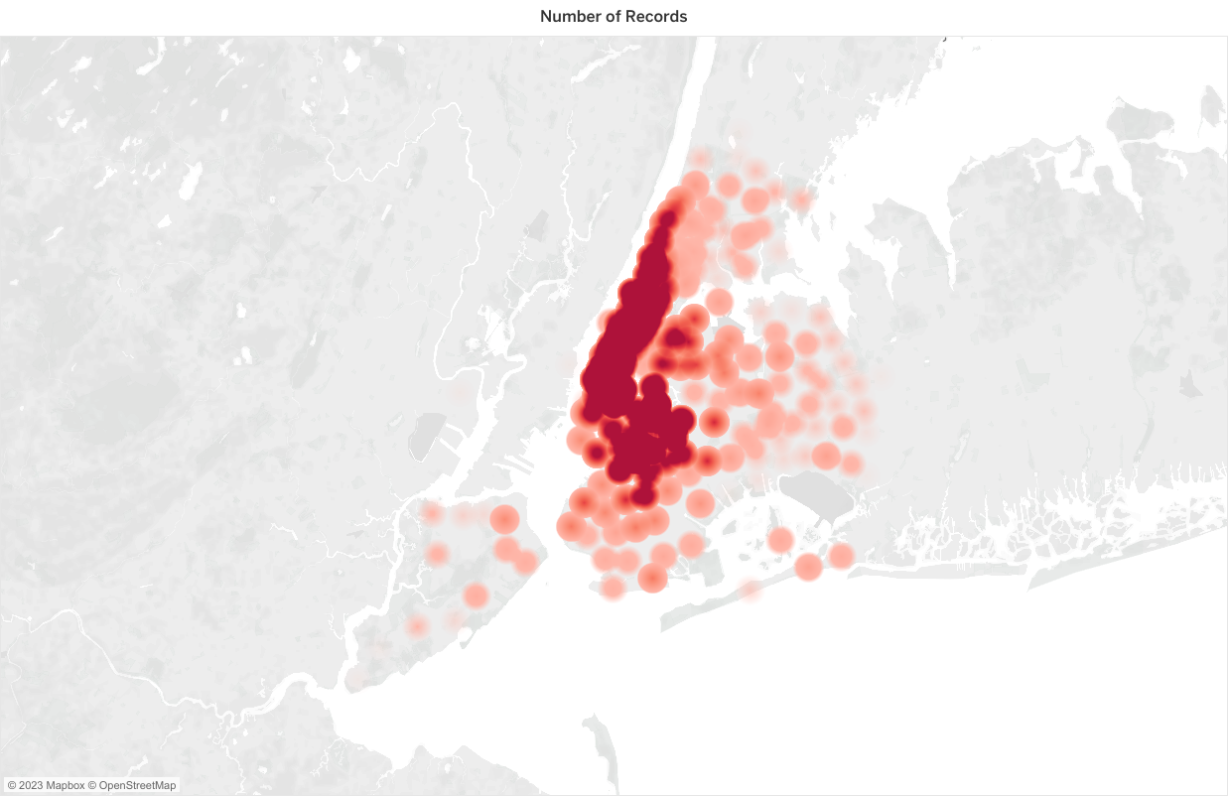

Slide 6
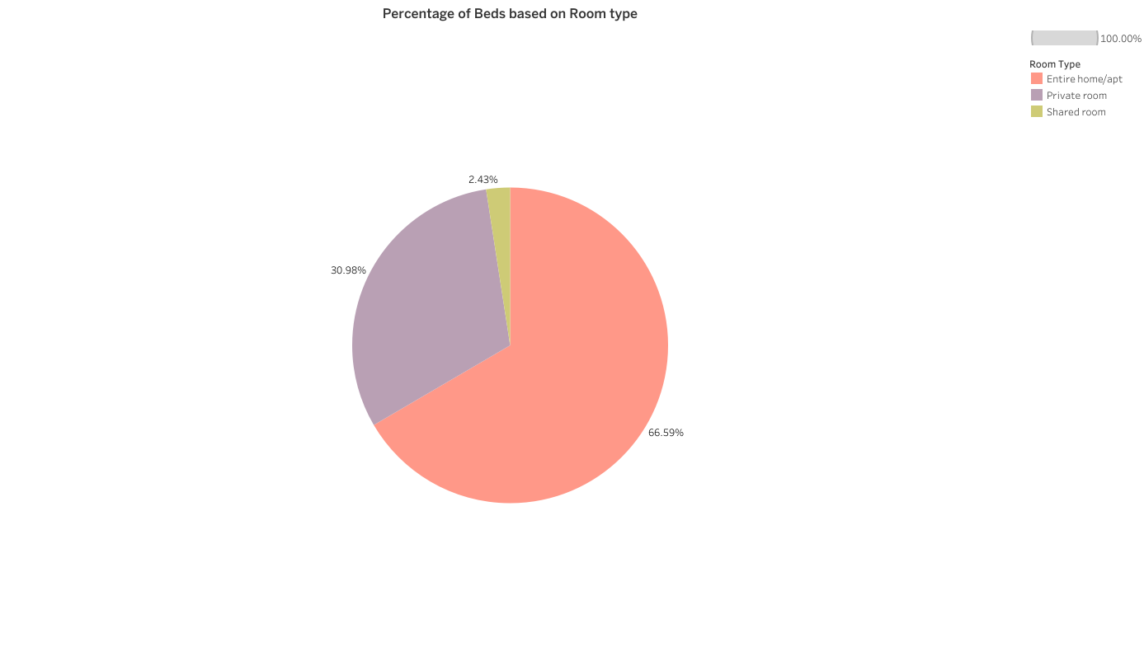

Slide 7
